Slide 1
ShanghaiTech University
EE 115B: Digital Circuits
Fall 2021
Lecture 3
Hengzhao Yang
September 28, 2021

Slide 2

EE115 Analog and Digital Circuits
Topic 4: Number Systems, Operations and Codes
Prof. Yajun Ha
ShanghaiTech University
Shanghai, China
This set of slides is by © Pearson Education

Slide 3
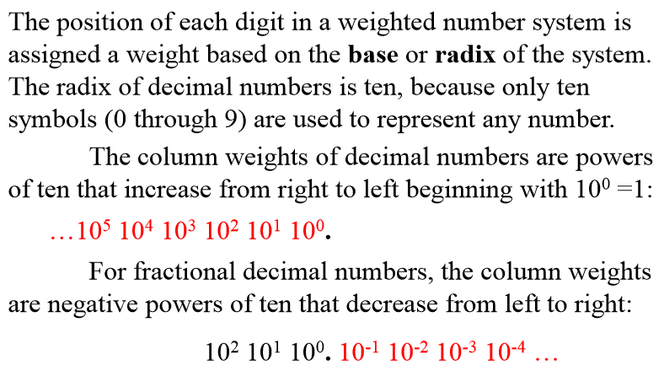
Decimal Numbers (1)

Slide 4
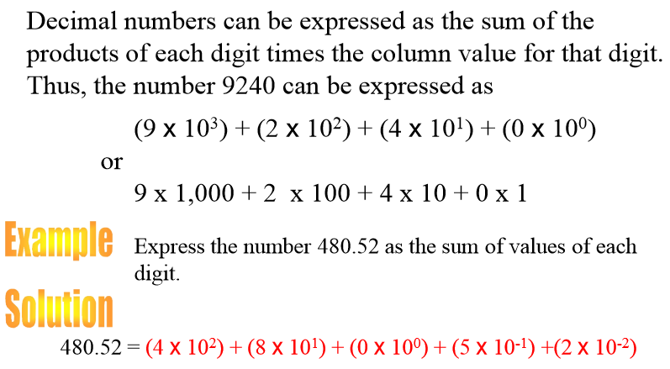
Decimal Numbers (2)
Prof. Yajun Ha
Notes:
Title

Slide 5
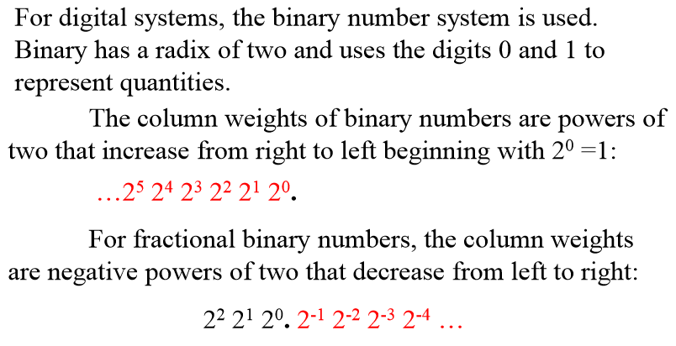
Binary Numbers (1)
Prof. Yajun Ha
Notes:
Title

Slide 6
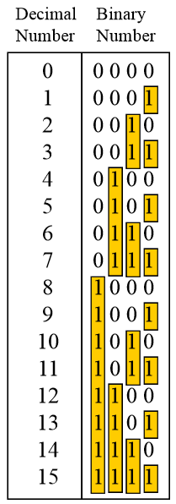
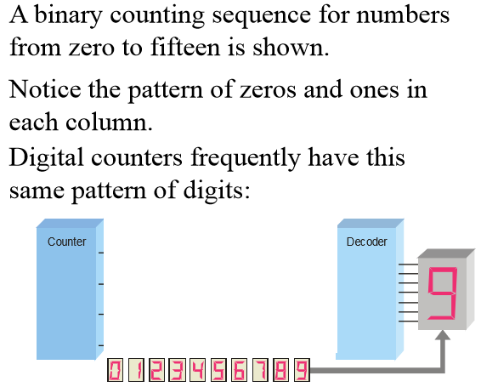
Binary Numbers (2)

Slide 7
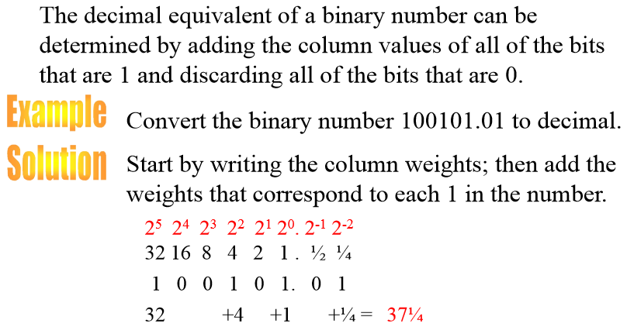
Binary Conversions (1)
Prof. Yajun Ha
Notes:
Title

Slide 8
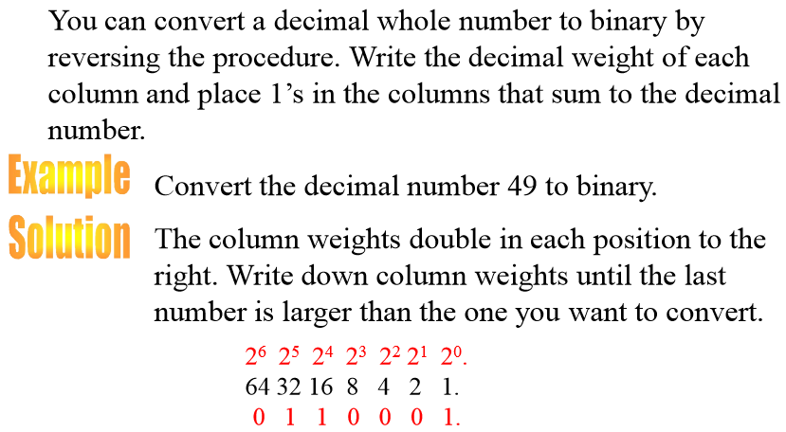
Binary Conversions (2)
Prof. Yajun Ha
Notes:
Title

Slide 9
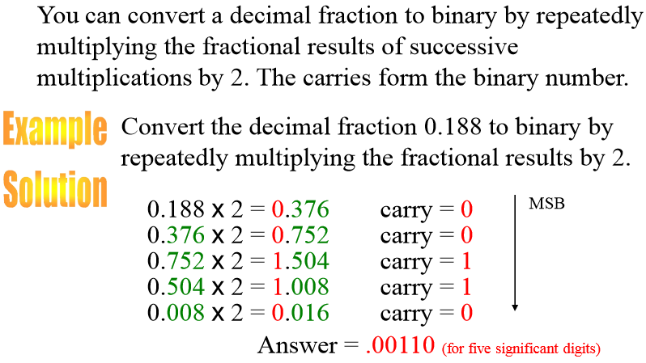
Binary Conversions (3)
Prof. Yajun Ha
Notes:
Title

Slide 10
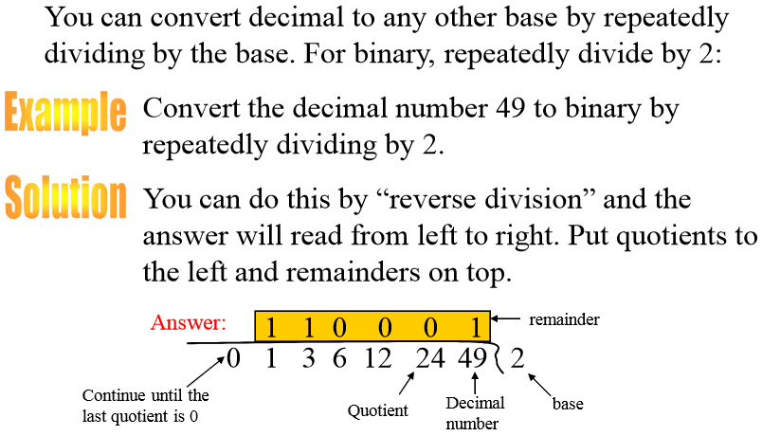
Binary Conversions (4)
Prof. Yajun Ha
Notes:
Title

Slide 11
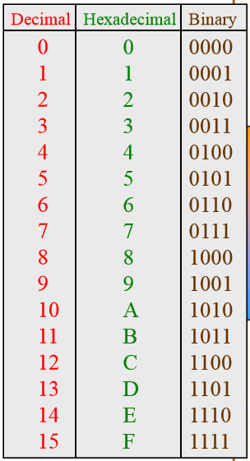
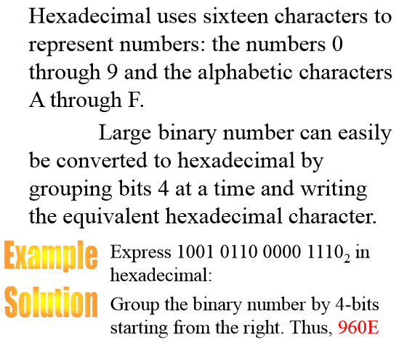
Hexadecimal Numbers (1)
Prof. Yajun Ha
Notes:
Title

Slide 12
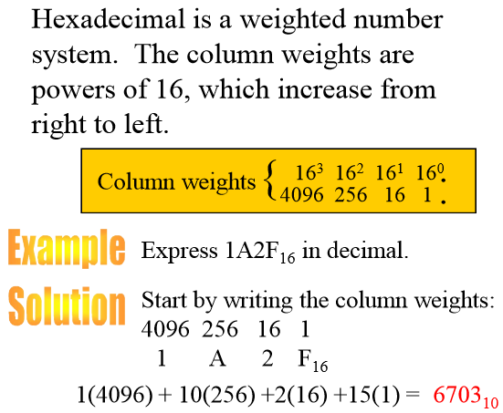
Hexadecimal Numbers (2)
Prof. Yajun Ha
Notes:
Title

